Slide 1


Azure Cosmos Db
By TBOLT

Slide 2
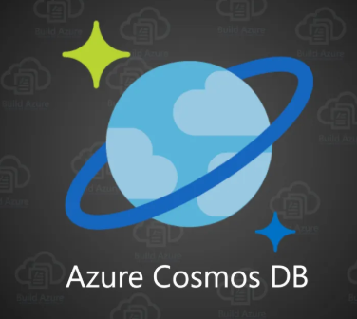
Azure Cosmos DB
Azure Cosmos DB is Microsoft's globally distributed, multi-model database service, Its an fully managed database service with turnkey global distributing and transparent multi-master replication
With a click of a button, Cosmos DB enables you to elastically and independently scale throughput and storage across any number of Azure regions worldwide. You can elastically scale throughput and storage, and take advantage of fast, single-digit-millisecond.

Slide 3
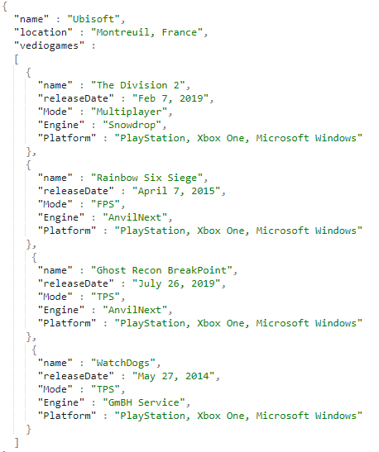
What is a document ?
A document is nothing but an JavaScript Object Notation(JSON) is an open-standard file format that is human-readable text to transmit data objects consisting of attribute – value pairs and array data type (or any other serializable value)

Slide 4
Features of Cosmos Db
Globally Distributed
Linearly Scalable
Schema-Agnostic Indexing
Multi-Model
Multi-API and Multi-Language Support
Multi-Consistency Support
Indexes Data Automatically
High Availability
Guaranteed Low Latency
Multi-Master Support

Slide 5
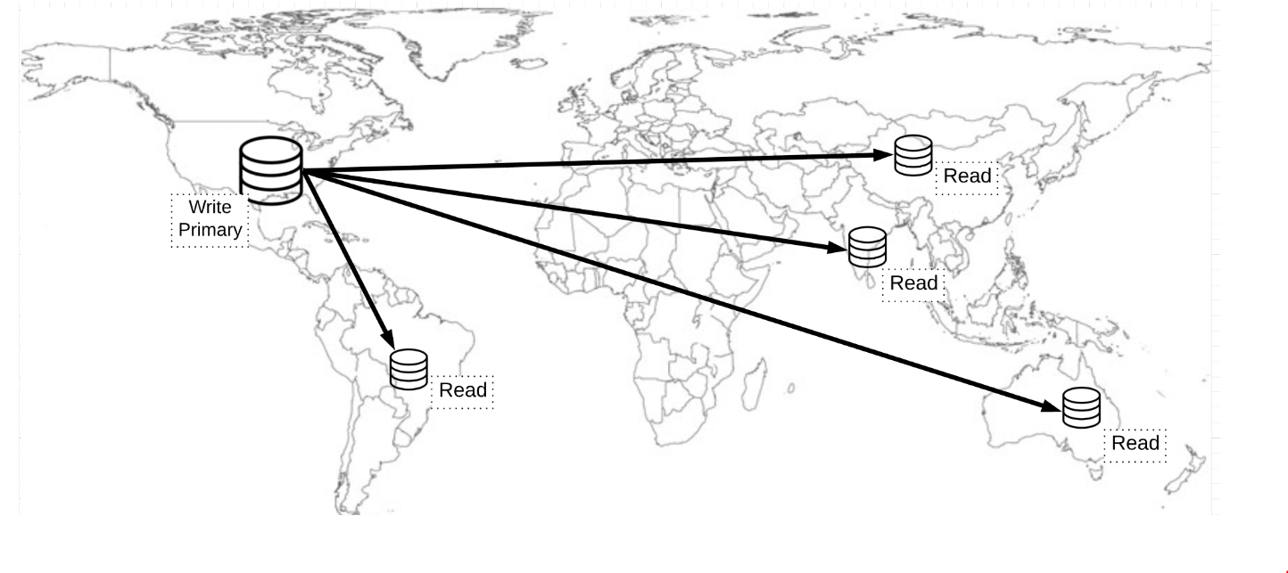
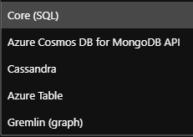
Features of Cosmos Db
Cosmos DB APIs

Slide 6
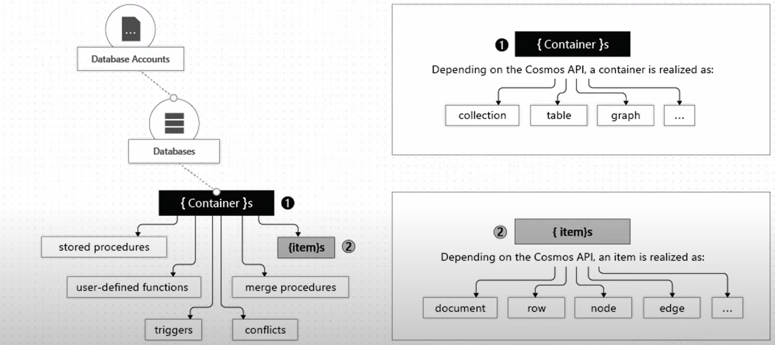
Cosmos Db Structure

Slide 7
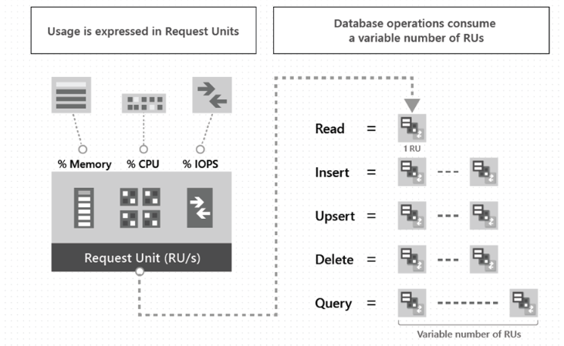
Request Units
The cost of all database operations is normalized by Azure Cosmos DB and is expressed by Request Units (or RUs, for short). You can think of RUs per second as the currency for throughput.
RUs per second is a rate-based currency. It abstracts the system resources such as CPU, IOPS, and memory that are required to perform the database operations supported by Azure Cosmos DB.

Slide 8
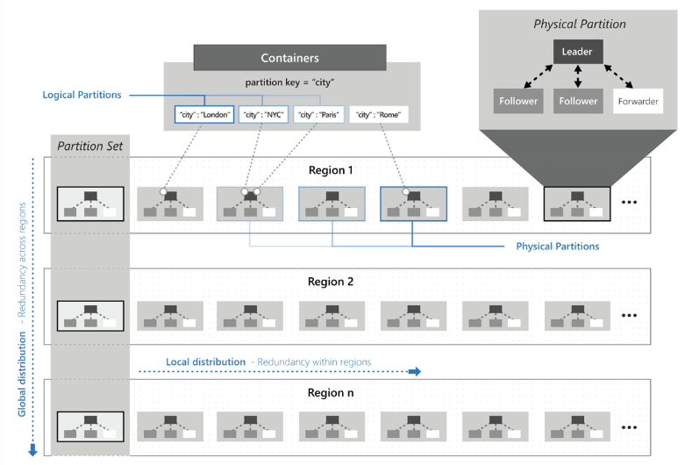
Partitions
In partitioning, the items in a container are divided into distinct subsets called logical partitions. Logical partitions are formed based on the value of a partition key that is associated with each item in a container. All items in a logical partition have the same partition key value.
There are two type of partitions:
Physical
Logical

Slide 9
SQL API
Azure Cosmos DB API accounts support querying items using Structured Query Language (SQL)

Slide 10
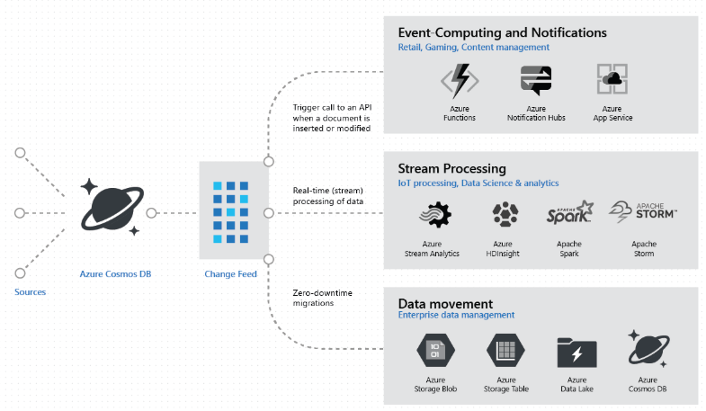
Change feed

